Slide 1
Spencer Powell Brain Fitness Program
Physical Activity Module

Slide 2
Module Outline
Check-in and review
Benefits of physical activity
Memory exercise
Goal setting

Slide 3
Check-in
How did your week go?
Did you think about anything you learned last week?
Did you log your activities?
Any questions about the CR Contribution Logs?
What is Cognitive Reserve?
How can knowing about this theory help you?
What was the Memory Strategy that you learned last week?
Did you have a chance to use it?
If you didn’t get the chance to use it, imagine a couple of scenarios where you might use the memory strategy. Remember, memory strategies are really only effective when they are practiced!
Notes:
Last week’s memory strategy was:
Improving Attention to Improve Memory
Look Up and Around
Put in the Effort
Stay “Present”
Get your Hearing or Vision Checked
Manage Your Environment
Reduce Distractions and Interruptions
Do One Thing at a Time
Multi-tasking is a Myth!
Multi-tasking can be toxic to the brain
Bribe yourself
Get Plenty of Rest
If not rested, you may need to see a sleep doctor
Resting when you’re awake
Manage your Emotions

Slide 4
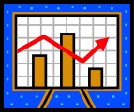
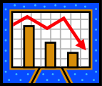
Investing in Brain Health
Maximize Contributions
Dementia
Threshold
Minimize Losses
Low Reserve
High Reserve
Notes:
In the last module you learned about actively investing in your Cognitive Reserve, which you can think of as your Brain 401K. Maximizing your contributions to your brain can help you build up a larger reserve in order to ward off dementia.
What activities come to mind when you think of investing in your Brain 401(k)?
In the last module, you learned about an autopsy study that identified people who had resisted the clinical effects of Alzheimer’s disease growing in their brains. There were three main lifestyle behaviors that seemed to distinguish these people from people who had lost their independence. They had been more active during their lives in a few key ways.
Can you recall the ways they had been more active?
This module focuses on how physical activity contributes to brain health. In fact, physical activity may be one of the best things you can do for your brain.
This could be a drop down question with 3 fields for people to select from a range of lifestyle options.

Slide 5
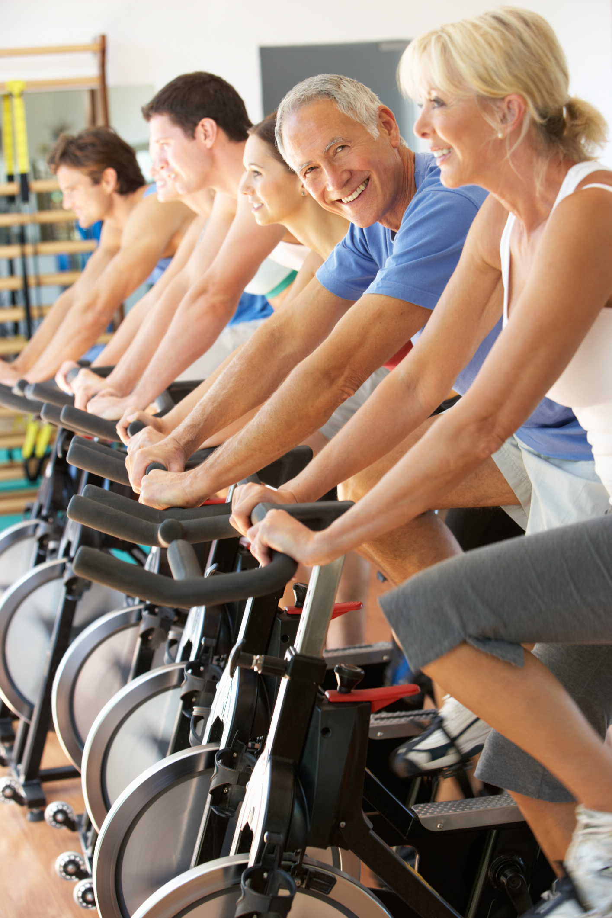
Exercise helps us to:
Maintain a Healthy Weight
Decreased body fat
Increased lean body mass
Increased resting metabolism
Better digestion
Prevent and Manage Chronic Diseases
Cardiovascular fitness (Heart, Blood Pressure, Stroke)
Prevent and control adult onset diabetes
Increased insulin sensitivity
Maintain a Strong Body
Increased bone density and reduced osteoporosis
Reversed physical frailty
Improved balance
Fewer falls
Reduce depression
Get better quality sleep
But now we know two new benefits of physical activity
Delayed onset of cognitive decline!
Better memory performance!
Notes:
We already know that staying physically active, often through exercise, is good for us in a lot of ways.
It helps us to…
Maintain a Healthy Weight
Decreased body fat
Increased lean body mass
Increased resting metabolism
Better digestion
Prevent and Manage Chronic Diseases
Cardiovascular fitness (Heart, Blood Pressure, Stroke)
Prevent and control adult onset diabetes
Increased insulin sensitivity
Maintain a Strong Body
Increased bone density and reduced osteoporosis
Reversed physical frailty
Improved balance
Fewer falls
Reduce depression
Get better quality sleep
But now we know two new benefits of physical activity
Delayed onset of cognitive decline!
Better memory performance!
As you’ve been learning, scientists have discovered that the brain stays plastic (changeable) all the way into our later years. This means that the brain can change in response to exercise no matter how old or young you are.
Think about your answers to the following questions:
Have you felt or seen benefits of physical activity in yourself or others?
Have you seen or felt cognitive benefits of physical activity in yourself or others?

Slide 6
How does physical activity reduce cognitive decline?
Vascular Health
Physical Activity
Cognitive Performance
Notes:
There are two proposed routes through which it seems that physical activity reduces cognitive decline.
(Click to Animate Slide)
The route that has been understood for some time is an indirect route. For a long time, scientists believed that the link between physical activity and cognitive performance was primarily influenced by vascular health, which involves the ensuring proper blood circulation.
(Click to Animate Slide)
But more recently evidence suggests that physical activity also seems to have a direct impact on cognitive performance, which we will discuss in a moment.
But first let’s get a better understanding of the impact that your vascular health on your brain performance and aging.

Slide 7

High Blood Pressure and Cognitive Decline
High blood pressure is bad for your brain!
However, if you treat your high blood pressure, you can protect your brain.
Notes:
High Blood Pressure
High blood pressure, high cholesterol, heart disease, diabetes and mini-strokes are all related to cognitive decline, but it appears that of all these conditions, high blood pressure may be the worst culprit!
Blood pressure above or below the healthy level in middle-aged men has been associated with poor performance on cognitive tests 25 years later.
However, this association between high blood pressure and decreased cognitive performance was only found in men who did not treat their blood pressure. This suggests that if we do something to attend to our health problems we can help to prevent or postpone onset of cognitive decline. High blood pressure and poorer health ratings were also more predictive of cognitive deficits in younger old adults versus older old adults, meaning that it seems that these health conditions promote premature brain aging.

Slide 8

Other Vascular Conditions Linked to Cognitive Decline
Heart disease
Diabetes
Obesity
Stroke
Notes:
High cholesterol increases the risk for heart disease, and a healthy heart is essential to having a healthy brain.
Diabetes and pre-diabetes (insulin resistance) can damage the blood vessels that bring important nutrients to brain cells.
Stroke and diabetes consistently and reliably predicted cognitive deficits.
As we just discussed, physical activity seems to play a role in preventing or reducing the impact of all of these medical conditions related to vascular health, so this is an important way that exercise protects our brains.
Cerebrovascular disease , a term to describe the whole range of vascular-related damage to the brain including strokes, is a serious medical condition. It is also the 4th leading cause of death in people over 65, more than Alzheimer’s, which is #5.
[[What is this activity??? How is it that these vascular conditions reduce our cognitive reserve? Click here to find out more. ]]

Slide 9
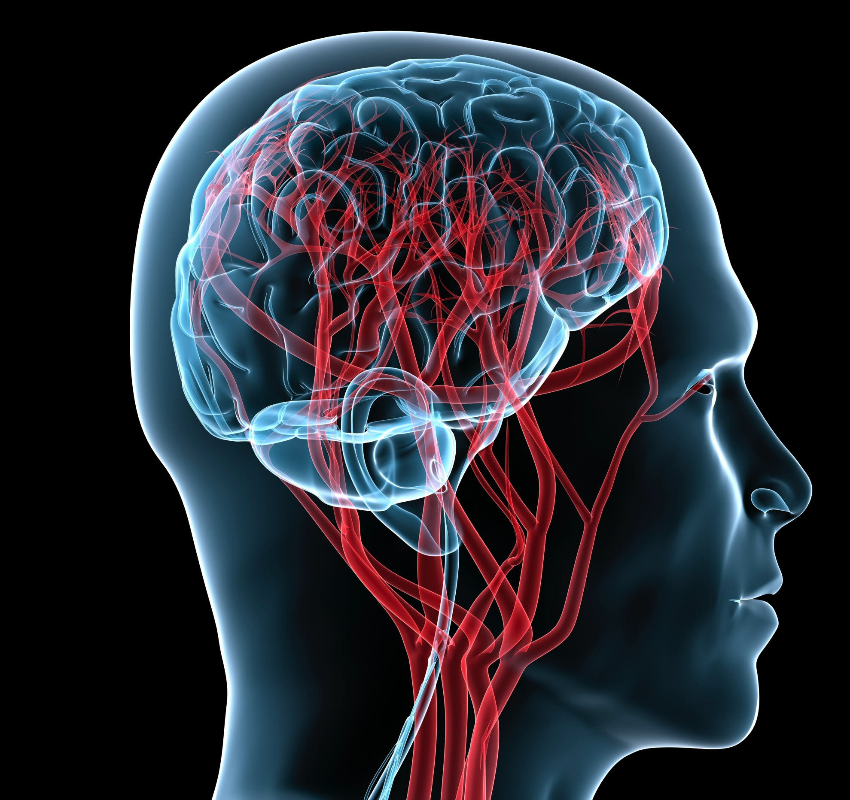

Slide 10
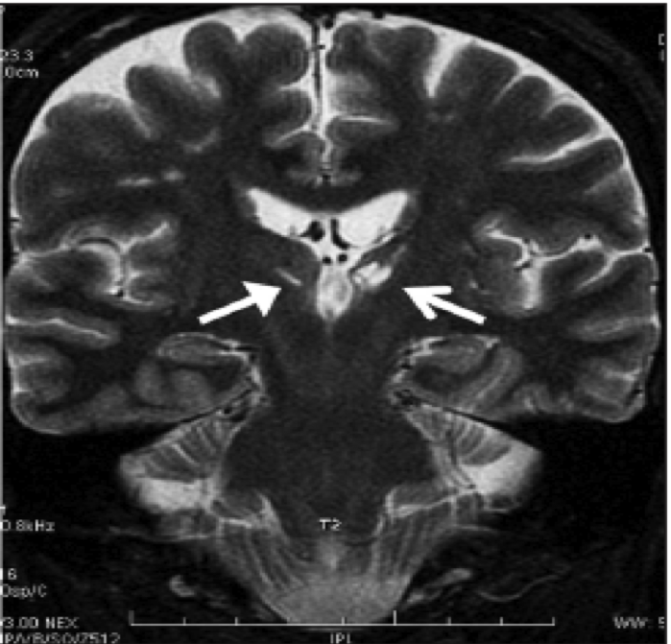
White Dots
Notes:
Brain cells needs a constant and robust supply of blood flow to stay alive. Unlike other cells in your body, neurons (brain cells) cannot store the oxygen and glucose (sugar) they need to survive. Any interruption in blood flow for even just a few minutes can cause significant cell death and thus brain damage.
High blood pressure, high blood sugar and high cholesterol can create conditions that interrupt the blood supply contributing to the form of dementia we call Vascular Dementia. Vascular dementia has many names including: cerebrovascular disease, stroke, TIA, mini-stroke, and “white dot syndrome.”
The term "white dots" (also called white matter hyperintensities) comes from the way that vascular-related damage to the brain shows up on a certain type of MRI picture.. In this type of image, the tissue for what we call “white matter tracks” normally show up as black. White matter tracks are bundles of the connective fibers through which brain cells communicate with one another. When these tracks are damaged, they show up an MRI as white instead of black, hence the name "white dot syndrome." You can see the white dots on this image inside the red circles . The big white dots around outside the red circles are not white matter tracks and are supposed to be there.
Most of us are familiar with the effects of stroke and maybe even TIA’s, which are basically just short-acting strokes, but you may not be familiar with this “white dot syndrome,” because these white dots often occur without any symptoms. The white dots form from an accumulation of little silent strokes. The effects on thinking build up over time, in many cases leading to dementia. White dots start forming somewhat early in adulthood, with some detected in people as young as their 30’s. They are common in the brains of older adults, and a certain number of them are considered to be “age appropriate,” but they work to deplete cognitive reserve. And since they are linked to high blood pressure, high cholesterol and diabetes, we can work to reduce or prevent them.

Slide 11
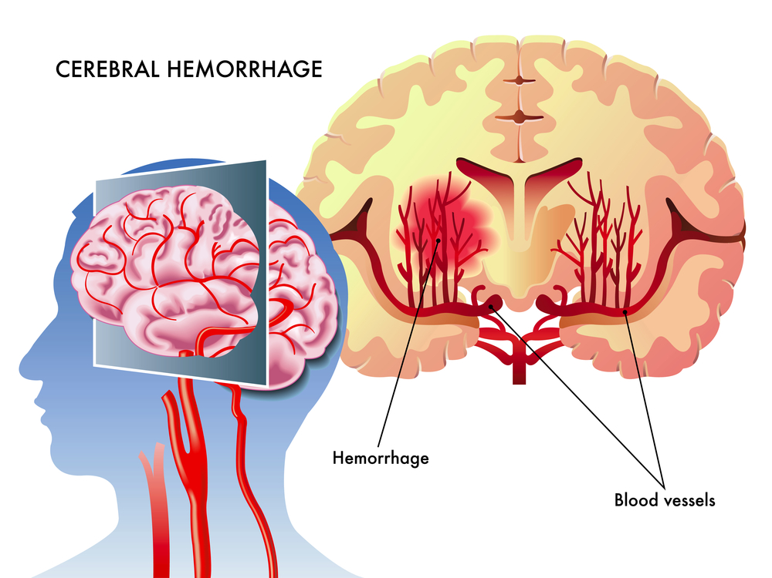
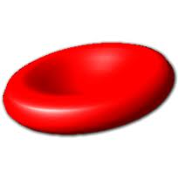
The Formation of White Dots
Red Blood Cell
Plaque
Plaque
Notes:
Knowing how these white dots form, will help you better understand the ways to prevent them.
White dots form because the deep internal structures of the brain, including those important white-matter (or communication) tracks are fed by blood vessels that are at that point very, very tiny. Chronic high blood pressure can cause these tiny blood vessels to burst, spilling blood into the area where brain cells live, which is toxic to them.
OR these tiny blood vessels can also “clog up” and prevent blood flow from reaching points beyond the clog, leading to tissue damage.
The things that “clog up” these capillaries are directly related to high blood pressure, high blood sugar and high cholesterol.
High blood pressure and high cholesterol lead to the build up of plaque in the arteries, sort of like the gunk that fills up in a slow kitchen sink pipe. If a piece of this plaque or an associated blood clot becomes loose & starts floating around in the blood stream, it can float freely in the larger blood vessels.
But if the plaque floats up to these small blood vessels, (Click to start animation) it will block blood flow to the tissue downstream.
The same type of thing happens when blood sugar is too high. High blood sugar causes the red blood cells to swell up, and this can block off small blood vessels in the brain or elsewhere as well. High blood sugar also damages the walls of blood vessels increasing the risk for high blood pressure.

Slide 12
How does physical activity prevent cognitive decline?
Increases Brain Volume
Increases Nerve Growth Factors
Increases Neurogenesis
IGF-1
BDNF
Physical Activity
Cognitive Performance
Notes:
In addition to protecting our vascular health and consequently, our brain health, more recent evidence suggests that physical activity seems to DIRECTLY influence cognitive reserve and cognitive performance.
Physical activity has been shown to…
Help us Grow More Brain Cells
Animal studies have shown that aerobic exercise (a rat running on a wheel) can have a profound effect on increasing the number of new brain cells that are born.
2. Help us Produce Chemicals to Support New Brain Cells
Physical activity has been found to increase a group of proteins called nerve growth factors.
These nerve growth factors help neurons and dendrites grow and thrive. Some have even referred to these growth factors as Miracle Grow for your brain cells.
3. Help You Grow More Blood Vessels in The Brain
We don’t often think about the dynamic nature of our vascular system, but new evidence has shown that regular physical activity helps new blood vessels grow in the brain, which can buffer some of the vascular effects we just discussed by creating “back-up” circuits for blood supply.
4. Help Increase the Size of Brain Structures
In humans physical cardiovascular exercise is linked to increases in the size of several brain structures, particularly the structure responsible for forming new memories (hippocampus).

Slide 13
Physical Activity and Cognitive Reserve
Reverses
1-2 YEARS
of age-related volume loss
+2% hypocampal volume
Better spatial memory
-1.4% hypocampal volume
(normal age-related decrease)
(Erikkson et al., 2010)
Notes:
For example, in a recent study, researchers put 120 healthy older adults participants on a fitness plan for 1 full year (Erikson, et al, 2010). Half of them (60) were assigned to a walking group 3 times per week and the other half (60) were assigned to a stretching and toning class that also met 3 days a week.
MRI brain scans were given before the program, half-way through the program (at 6 months) and at the end of the program (1 year after the first scan).
Before the program, the groups’ brain scans were not any different.
After 6 months and again after a year:
Volume in the hippocampus of the people in the stretching (control) group declined 1.4% (1.40% at 6-months and 1.43% at 12-months), which is on par with normal age-related volume loss.
But the volume of the people in the walking group INCREASED the by 2%,
The increase was 2.12% over baseline at 6-months and 1.97% over baseline at 12-months.
Effectively reversing age-related loss in hippocampus volume by 1 to 2 years
Now, what if you were up late one night watching an infomercial for some product that claimed it could “effectively reverse 1-2 years of age related brain volume loss.” You’d be intrigued, right? You might be suspicious about their claims, but I bet it would get your attention. Well now we have scientific evidence to show that something can provide this benefit, and you can get it practically for free. Maybe you’ll have to buy a new pair of running shoes…
Erikson, et al, 2010 http://www.pnas.org/content/early/2011/01/25/1015950108.full.pdf

Slide 14



Physical Activity Also Pays Immediate “Dividends” on Cognitive Performance
Active rats appear to be mentally sharper than sedentary rats.
Humans perform better on tests of attention and memory following periods of physical exertion.
Students performed better on standardized tests after a rigorous physical education course called PE4life was implemented.
Notes:
Rats that are allowed to run on a wheel are better at learning their way through mazes than rats that are forced to be more sedentary. (We aren’t rats but we use the in experiments because they can help us learn about ourselves).
Humans perform better on tests of attention and memory following periods of physical exertion.
A school in Titusville, PA was able to improve performance on standardized test scores from below average to 17% above average in reading and 18% above average in math seemingly purely from instituting a rigorous physical education course called PE4life.
Since so many of the changes in plasticity that seem to result from physical activity (new cell growth and brain growth factors) occur in the hippocampus (area responsible for forming new memories), scientists seem to agree that physical activity may directly influence the processes by which learning and memory occur.

Slide 15
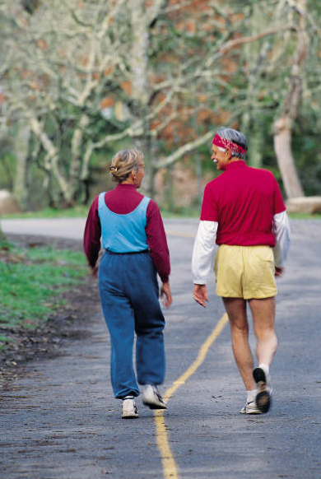
How much Physical Activity do we need?
Be active at least 2-3 X’s/week
2 times/week in mid-life = 60% less AD
3 or more times/week in later life =
32% less dementia after 6 years
The more the better
Every little bit counts
90 minutes of brisk walking/week
6-9 miles/week
Notes:
Some Science:
One study found that those who participated in leisure-time physical activity at least twice a week in midlife (between the ages of 40 and 55), lowered their odds of developing Alzheimer’s disease by 60%. The largest impact was in people who had a genetic predisposition to dementia (meaning that they carried the APoE-4 allele, a gene found to be linked to Alzheimer’s disease), but the effect of exercise was still significant in people without this gene-meaning that everyone’s risk for dementia seemed to be lower if they exercised.
Another study looked at regular exercise, which they measured by asking participants how many times a week they participated in a variety of specific types of exercise. They found that regular exercise was associated with a reduced risk for all types of dementia 6 years later. They also found that those who exercised 3 or more times per week had a 32% reduction in risk for dementia. The finding was greatest among those who had poor physical functioning at the start of the study.
A similar study found that those who participated in moderate or high levels of physical activity and were dementia-free at the beginning of the study had a significantly reduced risk of cognitive impairment 2 years later.
What it All Means:
The More the Better
It seems clear that the more physically active people are the better off they are. There doesn’t seem to be a point at which returns on your investment level off, which suggests that you may want to continue to push yourself to higher goals if you are already physically active.
But Every Little Bit Counts
However, you don’t have to immediately become a body builder or start training for marathons to reap the benefits of exercise. Researchers have found positive results when they analyzed physical activity, including walking.
The more walking, the better, but even walking briskly 90 minutes a week (that’s only 15 minutes a day) was all that was needed to improve cognitive outcomes and increased blood flow in the brain. That translates to about walking as little as 6-9 miles a week, which is really a just a pretty nice walk (2-3 miles), 3x/week. That seems doable doesn’t it?
There is still much research that needs to be done in this area to understand the relationship between exercise and specific types of dementia, but from what we know so far, exercise seems to be one of the best ways to protect your brain as you age. Exercise has some of the best evidence supporting it in terms of helping people build the “hardware” (brain cells) aspect of cognitive reserve.

Slide 16

Increasing physical activity: The FITT Principle
Frequency
Intensity
Time
Type
Notes:
As you may have noticed from the last couple of pages, it’s not just about how often you exercise. The brain benefits of exercise appear to increase when you increase several different factors related to your physical activity.
One group of scientists pulled together a series of research articles and thoroughly reviewed their findings. They found that the amount of impact that exercise had on cognition depended upon several factors including:
the length of the fitness-training intervention (weeks vs. months)
the intensity of the activity
the type of the physical activity
the duration of training sessions
Generally, higher levels of exercise at higher intensities for longer amounts of time throughout the life course appear to be most beneficial.
Because the risk of dementia decreases with increased intensity and duration of exercise, we recommend that people who already have a habit of exercising, set goals to step it up in some way.
So, when you are thinking about improving your brain health through increased physical activity, there are a few different dimensions that you can consider following the FITT Principle FITT stands for Frequency, Intensity, Time and Type. Here is what we mean by each of these:
Frequency of your workouts – how often you plan to do them. For example, will you walk every day or 4 days per week?
Intensity of your workouts – for example, are you going to walk at a brisk or a leisurely pace? Maybe you’ll step it up to jogging for a bit.
Time of your sessions – how long will you walk each time?
Type of your workout – will it in fact be walking, or another type of exercise such as swimming, playing tennis, lifting weights or something else.

Slide 17
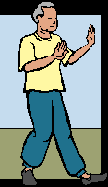
Types of Physical Activity
Endurance
Biking, stairs, dancing, jogging, machines, playing sports, brisk walking, swimming, yard work
Balance
Stand on one foot, heel-to-toe walk, tai chi, yoga
Flexibility
Full body: arms, neck, shoulder, back, legs,
calves, chest
Strength
Upper body: arm curl, arm raises, resistance bands, chair dip, wall push-up
Lower body: chair stand, toe stand, knee curl, leg raises
Notes:
Frequency, Intensity and Time for our physical activity is pretty straightforward, but what do we mean by Type?
Here are some examples of the major categories of types of physical activities. It may be important for you to consider doing a variety of different types of workouts because they can all be beneficial in different ways.
Endurance
We tend to experience the greatest benefit from endurance or “cardio” type exercises. These endurance types of activities include activities such as biking, stairs, dancing, jogging, cardio machines, playing sports, brisk walking, swimming, and yard work. The nerve-growth factor BDNF (remember, “Miracle Grow for brain cells”) has been associated with endurance type activities such as XXX
Balance & Flexibility
However, many of us can’t keep up with endurance routines without maintaining our flexibility and balance. When we were very young, balance was something that came naturally to us, but as we get older or lose core strength after events such as having a baby or a surgery, balance is something we need to work on to maintain. Flexibility is also often over-looked in terms of its importance. In order to maintain our range of motion to be able to do things like reaching a can on the top shelf or bending down to pick up something that we dropped without throwing our backs out we need to work on our flexibility. Stretching, yoga and tai chi are all good for maintaining flexibility and balance.
Strength
Finally, maintaining our strength is another key component that will allow us to continue caring for ourselves and keeping up with our daily activities. Strength training can also help build bone density and seems to help us generate a different type of nerve growth factor than endurance exercise (IGF-1).
Ideally, you should try to incorporate each one of these types of exercises into your routine.
Review the listed types of physical activities . What types of physical activity are you already active in? What physical activity is your favorite? Do you already practice all 4 types of activities? Where do you see room for “diversification” or improvement in your physical activity routine?

Slide 18
Making the most out of our daily activities
What are some ways you can (or already do) add physical activity into your daily life?
Park far away
Walk part of the way to your destination
Do an extra lap at the grocery store
Take the stairs instead of the elevator
Plan a walking date instead of a lunch
date
Wear comfortable shoes
Wear a pedometer
Notes:
Can you think of some ways to incorporate more activity into your daily life?
(show list)
Did you think of everything on the list?
Can you add some of these to your life?
Physical activity isn’t just about hitting the gym. You can gain a lot of brain benefits by living a lifestyle enhanced by as much physical activity as possible. There are a variety of ways you could easily increase the amount of activity in your daily life. Here are a few suggestions.
When you’re going to the store, park far away from the door in order to limit the time you waste looking for parking and to get more steps in your day.
Or even, park a block away from your destination – this way you don’t have to take time out of your day for your physical activity, just leave a few minutes early – as the research showed us, every bit of activity that we do will be beneficial to us.
Walk instead of drive.
Walking around the block in the middle of the day is a great way to take a break from whatever you are doing and refresh yourself and to burn some extra calories and benefit our brains!
Make 2 laps at the grocery store:
1) A Memory Lap: Make a grocery list, but don’t use the list when you shop – this is a way you exercise your memory
2) Then when you’re done, check the list and take another lap to get anything you missed – this helps you get some extra steps into your day and works your memory.
Stairs instead of the elevator. If this doesn’t work for you, you can even take the stairs up a few flights and then switch to the elevator if going up a lot of stories.
Fun Fact: One woman who worked at a desk all day said she never got out to do much walking. She decided that every time she had to use the restroom she would walk up then down a flight of stairs – she lost 10 pounds in 3 months! Find fun ways to add activity to your day.
Plan a walking date instead of a lunch date. Remember, plans with friends don’t always have to be over food – plan a date to get together to walk the mall, your neighborhood or a beautiful scenic path.
Wear Comfortable Shoes. If you wear uncomfortable shoes you’re likely to not walk as much as you might if your shoes are comfortable – so wear comfortable shoes everyday!
Wear a pedometer to help keep you conscious of the number of steps you are getting it – if it is 7pm and you realize you haven’t done much activity for the day you could do a few extra laps around your home or apartment just to get in that movement.
The U.S. Surgeon General recommends that, on average, everyone should walk 10,000 steps a day.
Your daily goal may be less or more, but this gives us a sense of where an average American should be doing in order to live an enhanced physically active lifestyle.
Keep weights in clear view – under the coffee table, somewhere where you will see them regularly as a cue to use them. Lift weights during commercials or while on the phone
Pace while talking on the phone

Slide 19

Standing
Sitting is the new smoking
Notes:
Another thing you can do to increase your activity and help your body is to take opportunities to stand as much as possible.
Modern life has us sitting more than ever before. The average person sits 9.3 hours per day, not to mention the 7.7 hours of inactivity we have when we are sleeping.
Researchers have uncovered some startling facts about the effect of sitting on our bodies:
Sitting increases death risk up to 40%. Those who sit 6 or more hours per day are 40% more likely to die in the next 15 years than those who sit less than 3 hours per day.
Sitting makes it harder for us to maintain a healthy body weight. People who are obese sit for 2.5 hours per day more than people who are thin.
People with sitting jobs have twice the rate of cardiovascular disease than people with standing jobs.
Some are starting to call sitting “the new smoking.”
What can you do now?
Uninterrupted sitting for long periods of time is the most detrimental to your health. The best thing to do is to try to interrupt your sitting with even a few minutes of standing or walking around before sitting back down.
Try to be active when you can. Many of us have reasons that we need to sit during certain points of the day. When you don’t need to sit, try to get up and move, even if it’s just a little more.

Slide 20

Memory Strategy #2
Visualization
Take mental snapshots
Imagine the route you will drive or walk to get somewhere
Notes:
Visualization: The Memory Palace
We use our verbal skills so much day to day that sometimes it seems as though most of us have forgotten that we also have a visual memory. We try to remember things by “telling ourselves” to remember it (auditory or verbal) as oppose to perhaps “picturing it” (visual). In fact, many scientists argue that our visual memories may be stronger than our verbal memories. They draw this conclusion from some memory studies but also because “language” or verbal skills evolved so much later than our visuospatial skills. Our visual memories may be so effective because they have been part of our brains longer as our hunter and gathering ancestors had to use them to navigate large distances to survive.
Let’s talk more about using “visualization” to improve our memories:
One quick way to use visualization is to take mental snapshots of things such as:
Where you placed your keys
Where you parked your car
The arrangement of items on your desk before you take them off to dust
The contents of your refrigerator
Even a list
You can also use your visual memory to help you memorize directions somewhere. Instead of relying on the GPS, you can challenge yourself to memorize a new or somewhat unfamiliar route.
If the route is brand new to you, then you can visualize the road signs that you will be on the lookout for and then imagine right and left arrows for the turns.
If you sort of know the area, then try visualizing the intersections where you will make each turn.
If you try this challenge then it will probably be a good idea to put the GPS or a map in the car just in case you get yourself lost.

Slide 21
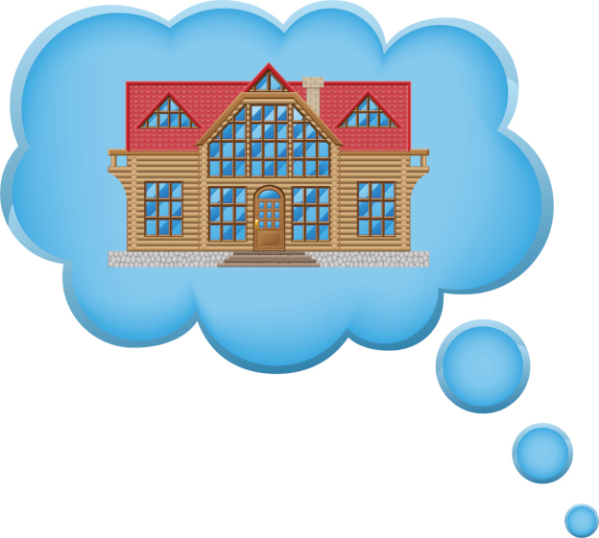
Memory Exercise
Visualization: The Memory Palace
Notes:
Visualization: The Memory Palace
For today’s memory exercise, you are going to learn about and practice a very powerful visualization exercise that can be used to memorize virtually anything, but it is particularly useful when it comes to memorizing lists. This technique is called the “Memory Palace” (it has also variously been known as the “Method of Loci,” the “Journey Method” or the “Roman Room Method”).
For the Memory Palace method you use your visual memory to help you out. You place vivid mental images of whatever it is that you are trying to remember around a familiar location. The easiest place to start is within a home that is solidly ingrained in your memory. For most people this is the home they grew up in.
Let’s take a moment to take a good look around this familiar space. Imagine the pathway or sidewalk leading up to the home, recall the look of the path leading up to the front door, imagine the entry way just inside the front door, look around the front room, walk down the hallway and recall a mental picture of each room along the way. Take a couple of moments to complete this mental tour of this memorable home as though you were there for an open-house.
Now we are going to remember a shopping list for brain healthy foods by placing very large, vivid, and humorous representations of them throughout the route we just took through this familiar home.
Here is the shopping list of Brain Healthy Foods:
2 bunches of salad greens
1 quart of blueberries
1 pound of shelled English walnuts
2 pounds of fresh wild salmon
A quart of low-fat Greek yogurt
2 bars of dark chocolate
3 bottles of red wine
Now, start off by imagining that as you’re walking up the pathway or sidewalk to the home, it has been neglected for some time and you have to push back large, over-grown leaves that look like salad greens or leafy lettuce that are taller than you are. Every time you move one out of the way a new one slaps you in the face.
The trick here is to imagine things that are absurd, unusual, humorous and even arousing in some way. Emotional memories are often more salient because they get an encoding boost from the emotional brain structures that live near the memory center, so try to make walking through this pathway as dramatic as a Hollywood movie.
So you finally make it through the overgrown salad greens and you arrive at the entryway. Blocking your way to opening the door is a container that looks like a quart of blueberries except that the container is the size of a hot-tub and there are little kids inside smashing blueberries over each other’s heads, making a colossal mess.
You finally manage to get the door open and once inside the entryway, you are met by a giant shelled walnut, dressed like one of the guards at Buckingham palace, asking you to give him a pound as a fee for passing into your childhood home. You pay the walnut and move into the living room where you see a whole, 2-pound salmon, disgusting mouth and all, laying across the vent on the back of the old television set, steaming from the heat coming off of the tube of the TV, causing it to cook a little and to stink a lot!
Moving down the hallway, you pass by the first room and see that inside there is another giant quart-sized-looking container of yogurt and a Greek god or goddess of your choosing is taking a bath in the yogurt. This god or goddess is skinny with “low-fat.” Moving farther down the hallway, you look inside a bedroom and see two giant bars of dark chocolate laid out on the bed as though they are sleeping side-by-side. It can help your memory if these bars of chocolate grow faces and you see them wake up and look at you. Finally you arrive in the kitchen and open up the refrigerator door to see three large bottles of red wine that also have faces and start “whining” at you, so you immediately close the door to make them stop being so annoying.
Now that you’ve taken your walk through your own “Memory Palace,” rehearse this path a few times later today, and you can how well it sticks with you in a week or two. You can refer back to the list here if you need to brush up on the items, but it’s possible through this exercise in what we call “elaborated encoding” that you may not have to reference it.
A great resource for learning more about this and a few other methods like it is the book Moonwalking with Einstein: The Art and Science of Remembering Everything by Joshua Foer, an entertaining account of how an average journalist (Mr. Foer, himself) trains to win the U.S. Memory Championship.

Slide 22
Can you remember the list?
Enter the items you remember below:
_________________________________________
_________________________________________
_________________________________________
_________________________________________
_________________________________________
_________________________________________
_________________________________________
_________________________________________

Slide 23
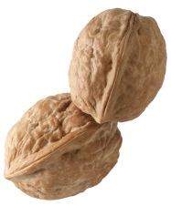


Did you remember everything?
2 bunches of salad greens
1 quart of blueberries
1 pound of shelled English walnuts
2 pounds of fresh wild salmon
A quart of low-fat Greek yogurt
2 bars of dark chocolate
3 bottles of red wine

Slide 24
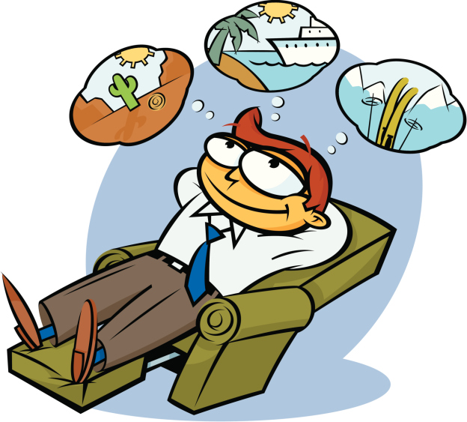
Sample Memory Goals
Practice the Method of Loci (Roman Room Method) for:
Lists
Poems
People’s Names
Work on developing new “Memory Palaces” by exploring familiar spaces
Practice taking Mental Snapshots
Memorize a new or unfamiliar route and test yourself
Notes:
The more Memory Palaces you have, the easier it will be for you to use the Memory Palace technique in different circumstances. So spend some time this week “revisiting,” (either literally or in your mind) familiar spaces that you can use as Memory Palaces. Then spend some time practicing this technique. Even though it is powerful (you may be surprised at how easily you remember the list of foods from this module) it does take some work, and as with most things, the more you practice them the easier they get.

Slide 25
Enter your memory goals below:
_________________________________________
_________________________________________
_________________________________________
_________________________________________
_________________________________________
_________________________________________
_________________________________________
_________________________________________

Slide 26
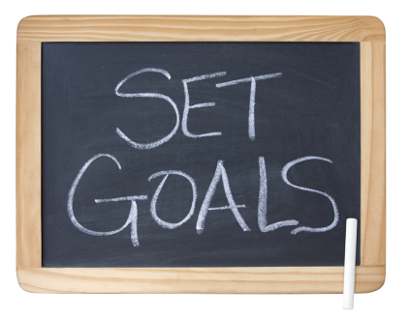
Goal Setting for Physical Activity
Identify a long term goal
Enter to walk in a 5K for charity
Work up to a daily exercise routine
Enter a pedometer challenge
Aim to buy new clothes in a size smaller
Notes:
Lifestyle changes are difficult. Creating both short and long-term goals has been found to be an effective way to help create and maintain new healthy habits.
Start by identifying a long-term goal, then create action steps for short-term (1-week) goals to help you reach your long term goals. Often times, long term goals are too daunting that we don’t even know where to begin! You can download the included goal setting worksheet to help you with this activity.

Slide 27

Action Steps for Physical Activity
Endurance
Walk 6000 steps 3 days a week
Swim laps 2x per week
Strength
Lift 2 lb weights for 10 minutes 3 times a week
Flexibility & Balance
Stretch/balance routine for 5 minutes before bed every night
Go to Yoga class once a week
Notes:
Short-term goals should be realistic, attainable, and specific.
They should also be something that you will enjoy and are likely to complete.
Include each element of the FITT principle where appropriate: Frequency, Intensity, Time and Type
Remind yourself of your action items – write them down, and keep track of your progress with the CR Contribution Log that you began in the last module.
Don’t let yourself get discouraged, remember, it is hard to start something new in life. It doesn’t matter how long it takes you to get to your long-term goals, just as long as you keep working towards it is what counts.
And make sure to reward yourself for your accomplishments. Changing your lifestyle is difficult to do and you need to be patient with yourself and give yourself credit for trying!

Slide 28
Enter your physical activity goals below:
_________________________________________
_________________________________________
_________________________________________
_________________________________________
_________________________________________
_________________________________________
_________________________________________
_________________________________________

Slide 29
This Week’s Goals
Memory Goal:
Goal: Practice a Roman Room using a grocery list, a to-do list, the names of people in this group, etc. once each day
Daily Reward: Five strawberries at dinner
Physical Activity Goal:
Goal: Increase the intensity of my daily walk (walk faster) for 5 minutes
Daily Reward: An extra 5 minutes relaxing in the shower
Make your goals:
Specific
Simple
Feasible
Notes:
Memory Goal:
Goal: Practice a Roman Room using a grocery list, a to-do list, the names of people in this group, etc. once each day
Daily Reward: Five strawberries at dinner
Behavior Goal:
Goal: Increase the intensity of my daily walk (walk faster) for 5 minutes
Daily Reward: An extra 5 minutes relaxing in the shower

Slide 30
Review Questions
What are some benefits of physical activity?
Physical activity helps people to:
Maintain a healthy weight
Prevent and manage chronic diseases
Maintain a strong body
Reduce depression
Get better quality sleep
Delay onset of cognitive decline
Improve memory performance

Slide 31
Review Questions
How does physical activity help your brain?
Improves vascular health
Increases brain volume
Increases production of brain cells (neurogenesis)
Increases production of nerve growth factors (BDNF, IGF-1)

Slide 32
Review Questions
Name three direct ways that physical activity seems to directly improve cognition.
Help us grow more brain cells
Help us produce chemicals to support new brain cells
Help us grow more blood vessels in the brain

Slide 33
Review Questions
What is the Memory Strategy for this week?
The Memory Palace (Visualization)

Slide 34
Review Questions
Are verbal memories (thoughts repeated in our heads) stronger than visual memories?
No, visual memories are stronger

Slide 35
Congratulations!
You’ve completed Module 2: Physical Activity and Brain Health
Be physically active to maintain a healthy brain!
Notes:
Physical Activity Helps the Brain by:
Improves vascular health
Increases brain volume
Increases production of brain cells (neurogenesis)
Increases production of nerve growth factors (BDNF, IGF-1)
White dots are silent strokes that can build up over time to cause cognitive decline (vascular dementia)

